Slide 1
BUS7C1 CORPORATE STRATEGY AND INTERNATIONAL MANAGEMENT
Lecture 9
Lecturer: Elan Kandaswamy

Slide 2

Today we will cover…
• Internationalization and international strategies
• Why internationalization
• Key dimensions of the international strategy
• How to Balancing the internationalization:
• Multidomestic strategy
• Global strategy
• Transnational strategy
• Some modes of Entry
• Managing strategy in International market
• What is 'backward' internationalization and Dealing with it.
• Four positions that multinational companies adopt in International Market

Slide 3
International strategy: Past and Present
• Traditional approach: The company’s approach to selling its products or service outside of its home market is known as its international strategy.
Issue: Problem with definition, Home Market? What if the company is online?
• Current approach: International strategy defines how the firm outlines its operations across multiple countries to reach sustainable competitive advantage.

Slide 4
Why internationalization
Access to Resources
The sourcing of goods and services from all around the globe to take advantage of local differences in the cost and quality of things such as labour, materials, capital and other resources.
E.g. Starbucks

Slide 5
Globalization of Production
Access lower-cost workers
Access technical expertise
Access production inputs

Slide 6
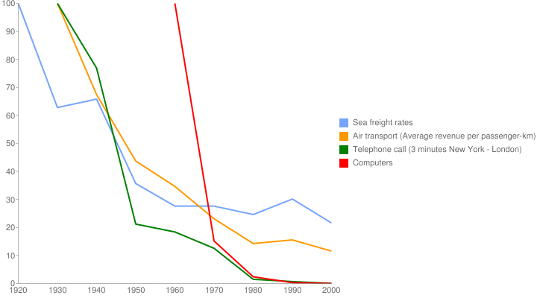
Cost of Transport and Communication

Slide 7
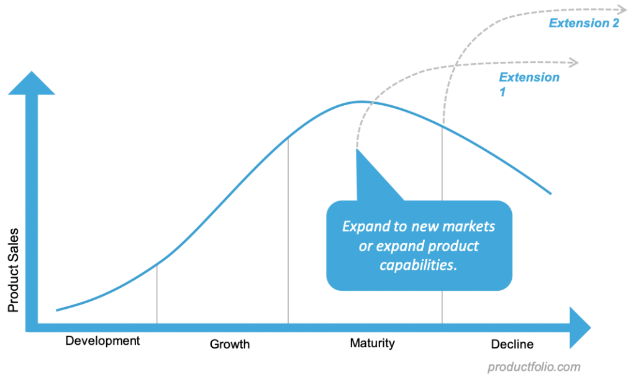
Reasons for internationalization
Extend the product life cycle

Slide 8
Some other Advantages of internationalisation
• Location advantages. Cheap labor/Energy/land/etc…
• Return on investment. The necessity for large markets to generate cash to pay for R&D e.g. Pharmaceutical companies, airplane companies Boeing, Airbus..Etc..
• Economies of scale/learning. Standardization in manufacturing and services.
e.g. Global production, Apple, BMW
e.g. someone answer from Philippines

Slide 9
Key dimensions of the international strategy
• Global integration
• Local responsiveness

Slide 10
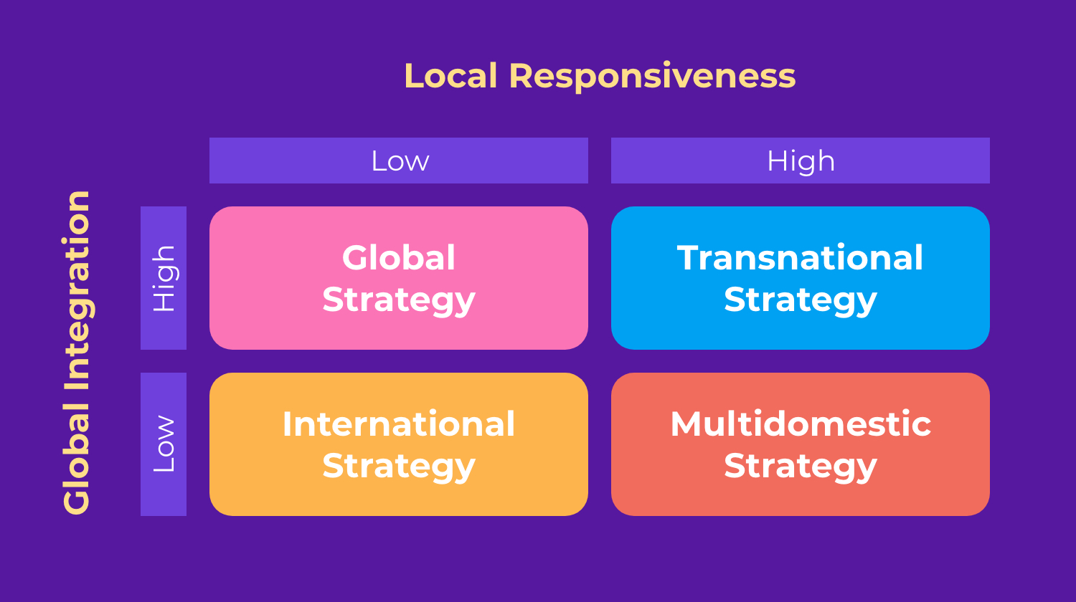

Slide 11
Multidomestic strategy
Multidomestic strategy -Nestle- Responding to the local demands.

Slide 12
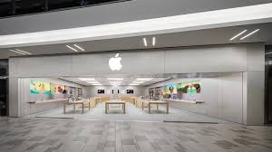
Global Strategy
Notes:
Global strategy: This strategy focuses on one global brand with very few changes in colors or messaging. Brands like Apple or Google do this well — they’re instantly recognized in any country, with very few differences between domestic and other markets.

Slide 13

Transnational strategy
Local responsiveness
Global integration

Slide 14
Some Modes of Entry
• Exporting: Selling a product or service produced in on country to a buyer in another country.(scale efficient but subjected to high transportation costs and tariff barriers). E.g., Modular design as a proposed solution.
• Licensing: One company owning intangible property (the licensor) grants another firm (the licensee) the right to use that property for a limited period of time.
(low risks and commitments but threat of loss of control over technology or product ) e.g. Disney

Slide 15
Some Modes of Entry
Franchising: One company (the franchiser) supplies another (the franchisee) with intangible property and other assistance over an extended period. E.g. KFC (low risks/costs but loss of control over quality). E.g. Danone Yogurt

Slide 16
Some Modes of Entry
Strategic alliances
• Joint venture: When two or more firms combine their equity and form a new third entity.
GM + SIAC = SAIC –GM Wulling
Advantage VS Disadvantage: (local expertise, shared risks/costs but loss of control and conflicts between partner)

Slide 17
Some Modes of Entry
Acquisitions: When a company own 100 % of the stock of a foreign entity by way of Foreign direct. Investment (FDI)
Amazon
Coca Cola
Google
Advantages
Tight control over a firm’s competitive advantage and technology
Control over operations( quality, strategy, use of profits, etc.…)
Allow the company to take advantage of economies of scale, comparative advantage, and other efficiencies.
Disadvantages
Very costly - £100m coca cola – innocent
High risk

Slide 18
Managing Strategy in International Market
• Expatriates vs. host-country nationals vs. third-country nationals
• Fighting cultural biases: =
• Cultural differences:
Power Distance
• Individualism/collectivism
• Uncertainty avoidance
• Masculinity/femininity cultures (quantity of life vs. quality)
• Understanding culture shock
• International management- Ethical issues

Slide 19
Power Distance
The extend to which the less powerful members of organisation and institution accept and expect that power distributed unequally.

Slide 20
Individualism versus collectivism
The degree to which people prefer to act as individuals rather than a member of groups and believe in individual rights above all else.
E.g.: United States Vs China

Slide 21
Masculinity vs. femininity
The degree to which the culture favours traditional masculine values versus feminine values.
E.g. Japan VS France

Slide 22
 | High Masculine | Low Masculine (Feminine)
social norms | ego oriented | relationship oriented
 | money and things are important | quality of life and people are important
 | live in order to work | work in order to live
politics and economics | economic growth high priority | environment protection high priority
 | conflict solved through force | conflict solved through negotiation
religion | most important in life | less important in life
 | only men can be priests | both men and women as priests
work | larger gender wage gap | smaller gender wage gap
 | fewer women in management | more women in management
 | preference for higher pay | preference for fewer working hours
family and school | traditional family structure | flexible family structure
 | girls cry, boys don’t; boys fight, girls don’t | both boys and girls cry; neither fight
 | failing is a disaster | failing a minor accident

Slide 23
Uncertainty avoidance
The degree to which people in a country prefer structured over unstructured situations defines their uncertainty avoidance.
E.g., Japan Vs Malaysia

Slide 24
Long-term Vs Short term orientation
Long term orientation look to the future; short term orientation values the here and now and accept change more readily.
E.G China Vs US

Slide 25
Indulgence versus restraint
The degree to which society indulges or restrains the basic and natural human drives related to enjoying life and having fun
E.g., UK Vs China

Slide 26
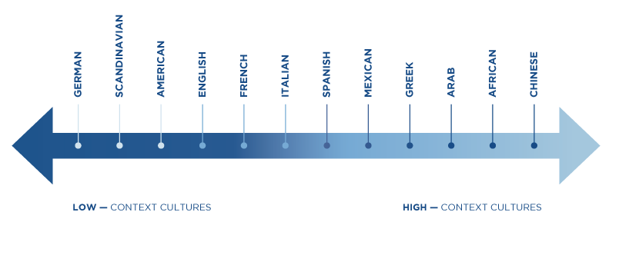
Low Context Vs High Context
Low-context cultures ( including the USA and most Western Europe) are logical, linear, individualistic, and action-oriented.
Communication: Clear, direct, and informative, you say what you mean.
Problem Solving: Get right to the issue and address it directly. It is not personal: we are here to solve the problem.

Slide 27
Low Context Vs High Context
High-context cultures ( including much of the Middle East, Asia, Africa, and Latin America ) are relational, collectivist, intuitive, and contemplative.
Communication: Formal language loaded with implied meaning cannot be understood outside the context of the situation.
Problem-solving: Work on the periphery of an issue to solve it, never directly addressing it. Calling attention to the problem directly shows disrespect and may cause another to lose face.

Slide 28
M Time Vs. P Time
Monochronic Time ( Dominant in low context cultures) Time is something to be praised, measured, and managed. In short, time is money.
M-Time complains that “ They are always late.”
Polychronic Time(Dominant in High contexts cultures) Time is something to be savoured and invested in the building and strengthen of relationships.
This cannot be neatly divided into 15-minute increments. P Time complains that “ They are always prompt.”
E.g.: Arab Vs Germans

Slide 29
'Backward' internationalization
• Businesses from developing nations entering developed markets.
• Industry effects: degree of competitiveness
• Institutional effects: rules of the game (regulative, normative/legitimacy, cognitive issues)
• Why expand into developed markets ?
• Enhanced learning opportunities- Access to more expertise.
• Lower level of institutional and country risk- e.g. Political tension.
• Greater market potential- Higher disposal income
• Availability of debt financing- Effective and Efficient bank system.
• Induced expansion (funds for expansion or business in the West).

Slide 30
Fighting low-cost Entry Fighting Hints:
• Differentiation: If you unable to ignore them, differentiate. Don't be afraid to charge more. If necessary, get ready to scale down or engage in M&A to respond to your price-sensitive customers.
• Process improvement: Make sure your differentiated features cost of product or cost.
• Diversification: Think about diversification into low-cost segment if it offers synergies with your existing business strategy.
• Changing to selling solutions: Get the customers addicted.
• If nothing of these works , A complete switch to low-cost models is advised.

Slide 31
Four positions that multinational companies adopt in International Market
Depending if this is a tactical or a strategic expansion to that country.
The Exploitive Position
The Transactional Position
The Responsive Position
The Transformative Position

Slide 32
The Exploitive Position
Concentrates on maximizing (short-term) shareholder interests.
• Differences in wages, legislation, living conditions and standards seen exploitable opportunities.
• No social responsibility.
• Engaging in questionable practices e.g. Bribery to obtain concessions from national governments.
E.g. Nike and child labor in southeast Asia.

Slide 33
The Transactional Position
• Concentrates on maximizing (long-term) shareholder interests
• abide to the law- commercial interactions.
Exploitation of own bargaining power
• Uses country differences to gain competitive advantage.

Slide 34
The Responsive Position
• Concentrates on maximizing shareholder and immediate stakeholders' interests through contributing to the business environments where it operates.
• Uses its bargaining power to positively affect working conditions of its employees.
• Reactive, not proactive.
• Push to higher standards.

Slide 35
The Transformative Position
• Concentrates on maximizing stakeholders interests and developing broader society.
• Creates new markets for itself by lifting people out of poverty and for partners by introducing them to global supply chain network
• Proactive
• Raises local standards
•e.g. Kinko Coffee

